Slide 1
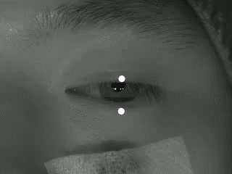
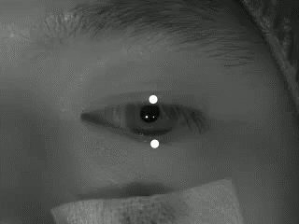
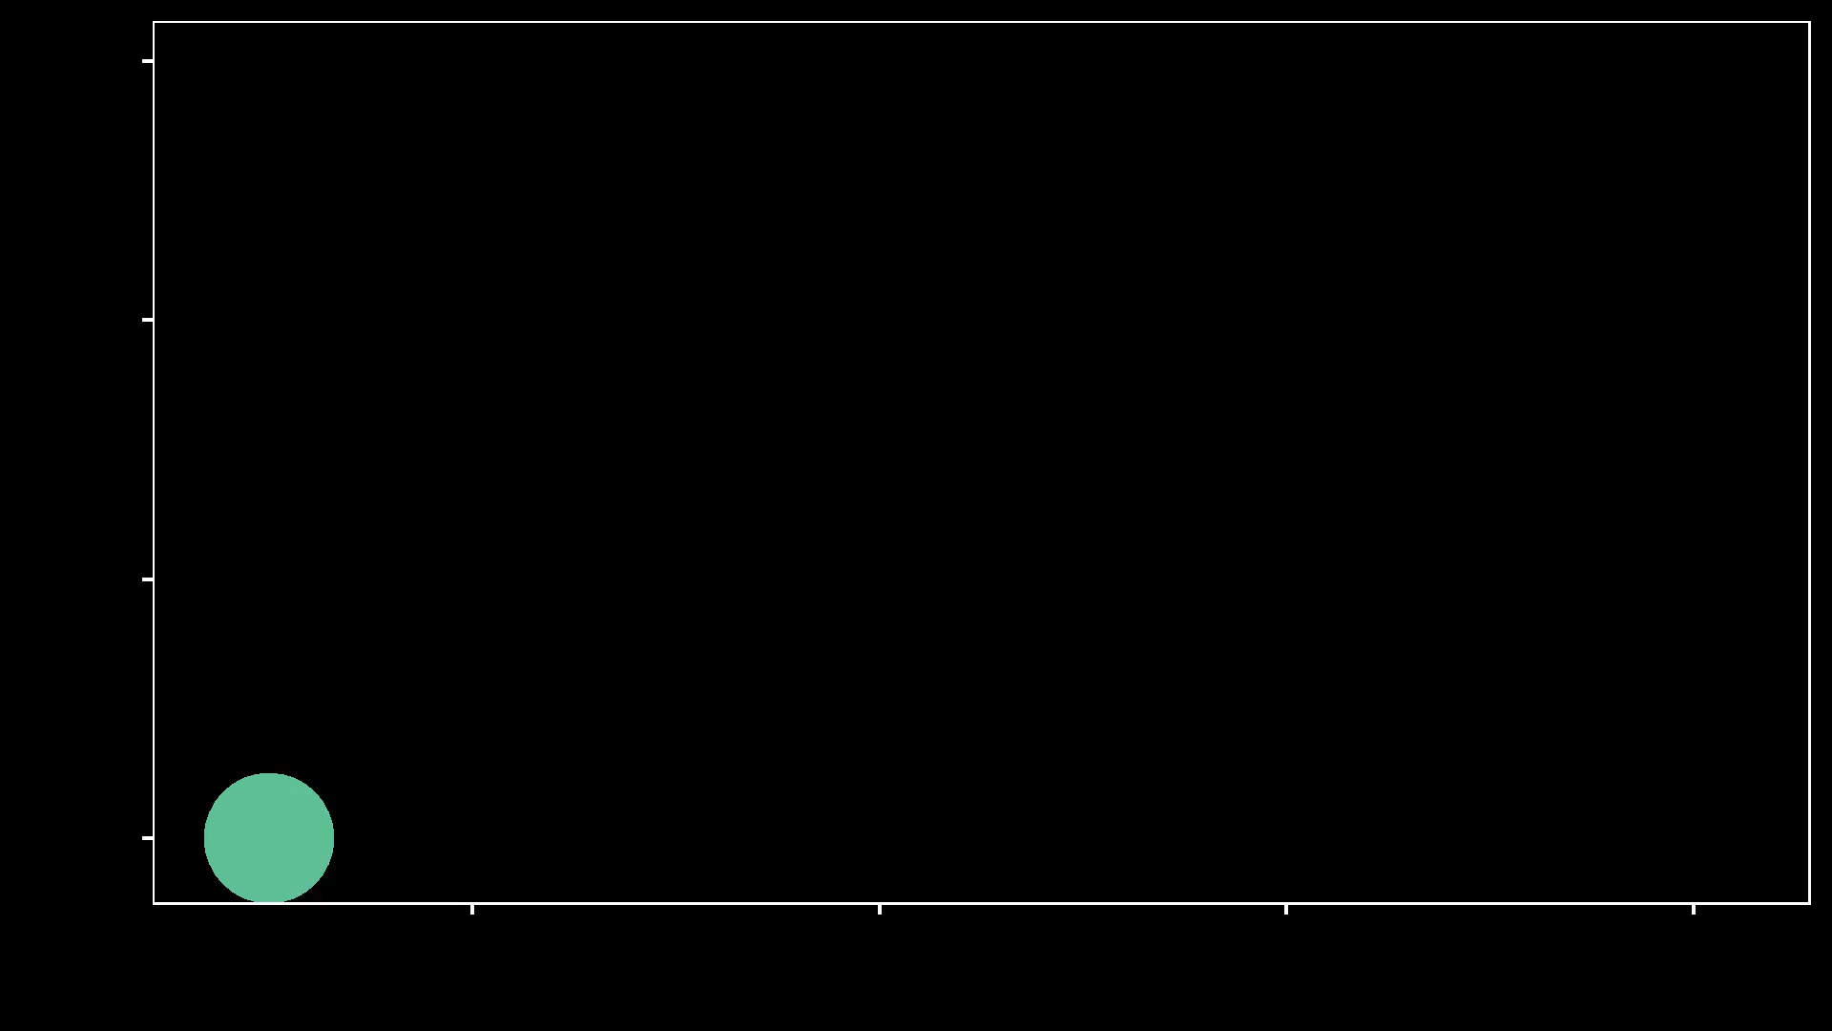
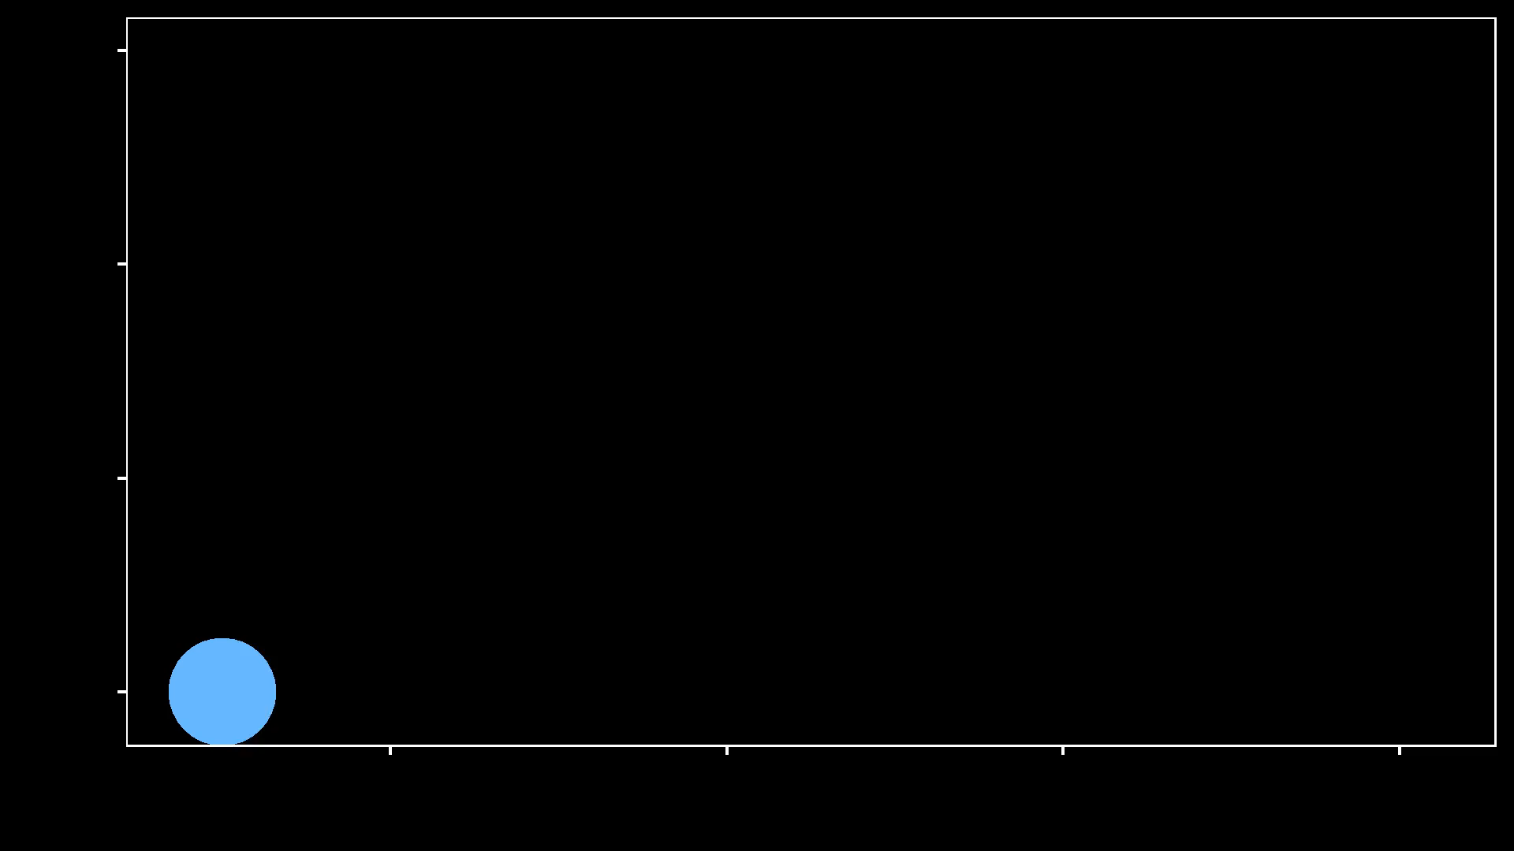
Max
Min
Min
Max
300
Potentials (in µV)
0
-0.2
0.0
0.2
0.4
-0.2
0.0
0.2
0.4
Time (in s)
Time (in s)

